Slide 1
AUGUST 10, 2022

Slide 2

General Changes
All table header make center
Color management : Approve (Green), Activate (#26a69a), Deactivated (Orange), Disapprove(red), Pending (same with the color below)
Remove the “x” in all modal pop up
On the date range picker must not be ahead on the current date
AUGTUST 11, 2022
Table header all bold text . Table data make it unbold, For all the data with heads and weight make it text-justify font-size maximize summary
For all the button with the dropdown selection replace a text to “Filter”
And add a search datatables template

Slide 3
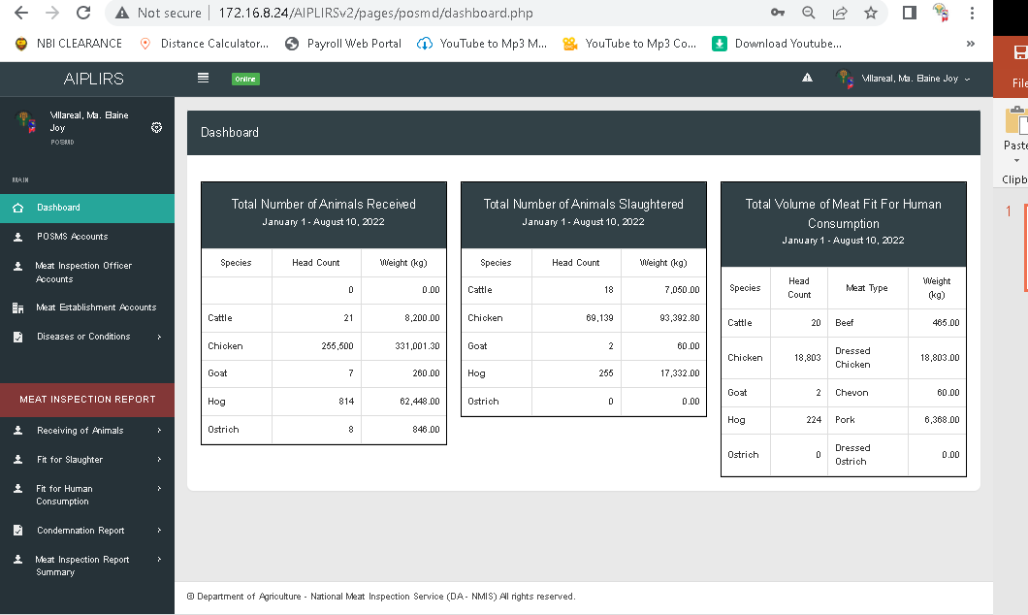
Undefined row data
Resolve: August 15, 2022

Slide 4
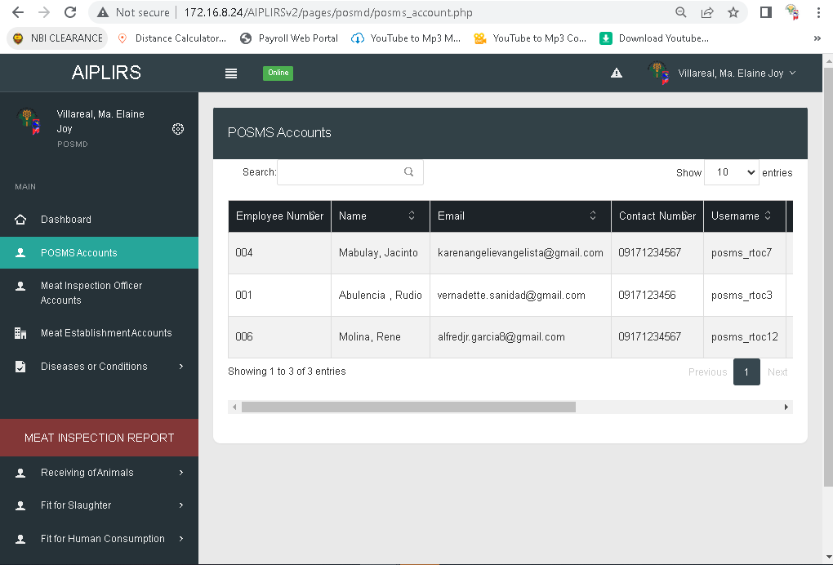
Limit to mobile number upon registration
Resolved: upon registration
Resolved: August 16 ,2022
POSMS account

Slide 5
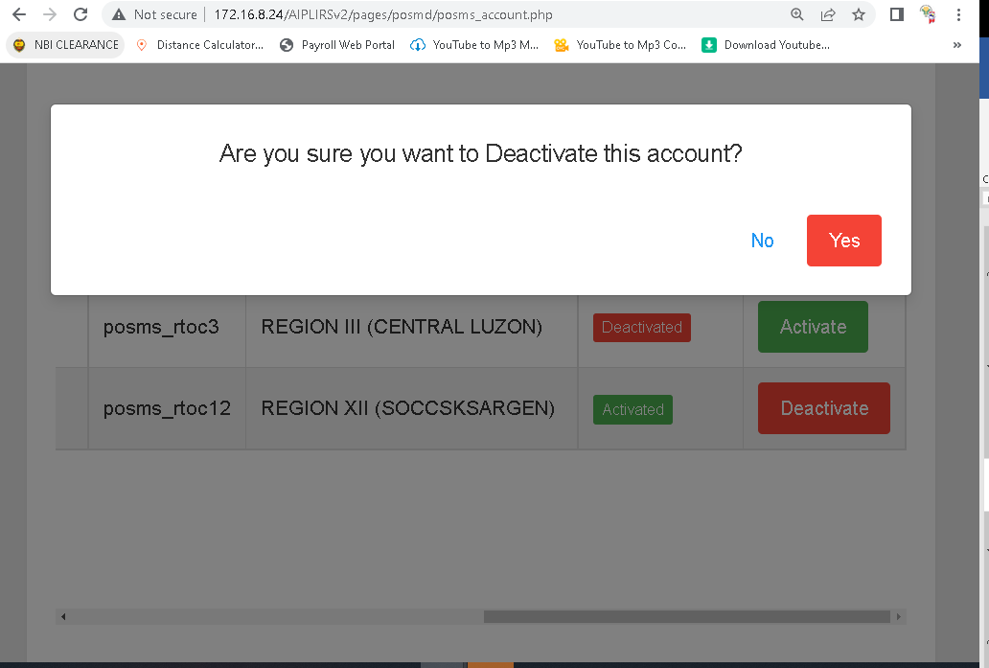
letter D make it small
Resolved:
August 16 ,2022
First “Yes” “No” : green and red make it center
Resolved: August 16 ,2022

Slide 6
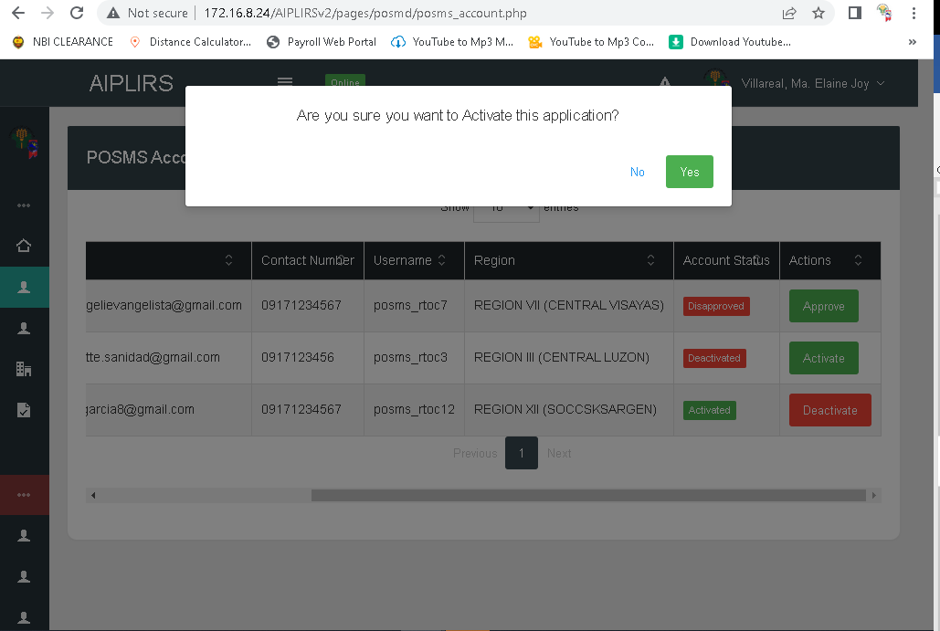
Change the message to application to account letter A make it small
Resolved: August 16 ,2022
First “Yes” “No” : green and red make it center
Resolved: August 16 ,2022

Slide 7
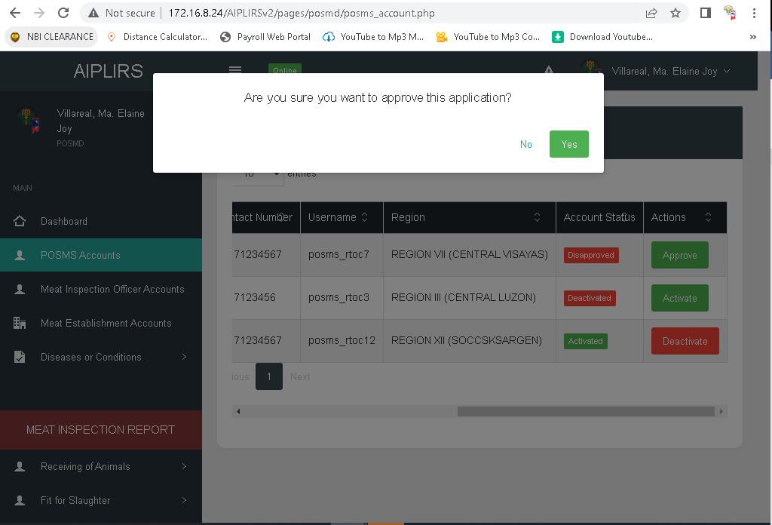
First “Yes” “No” : green and red make it center
Resolved: August 16, 2022

Slide 8
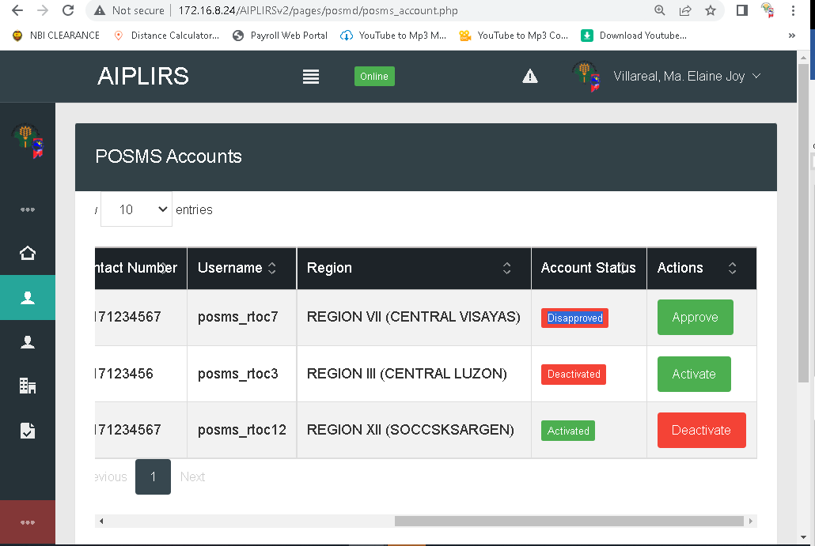
Change the color of disapprove and approve
August 16, 2022

Slide 9
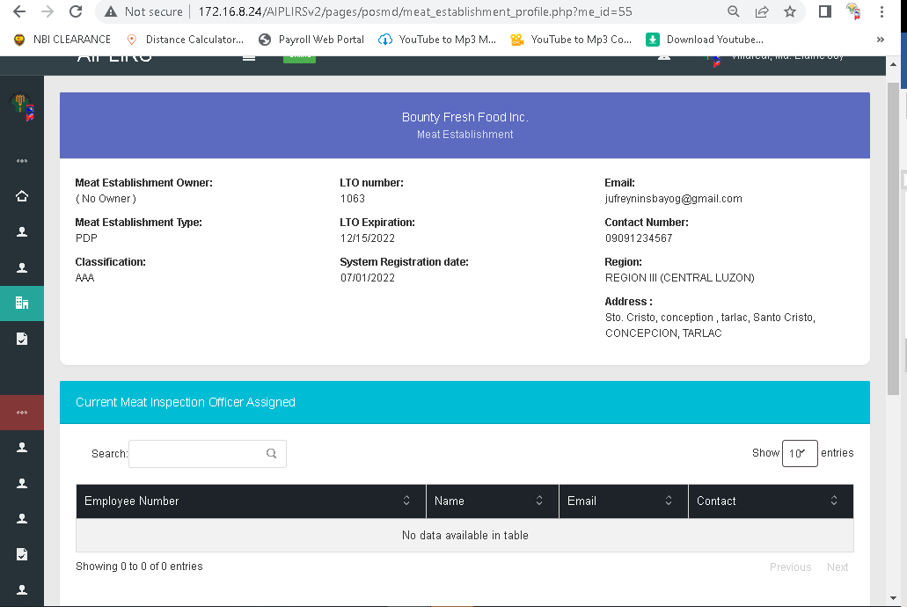
Capitalize “Number”, “Date”
August 16, 2022

Slide 10
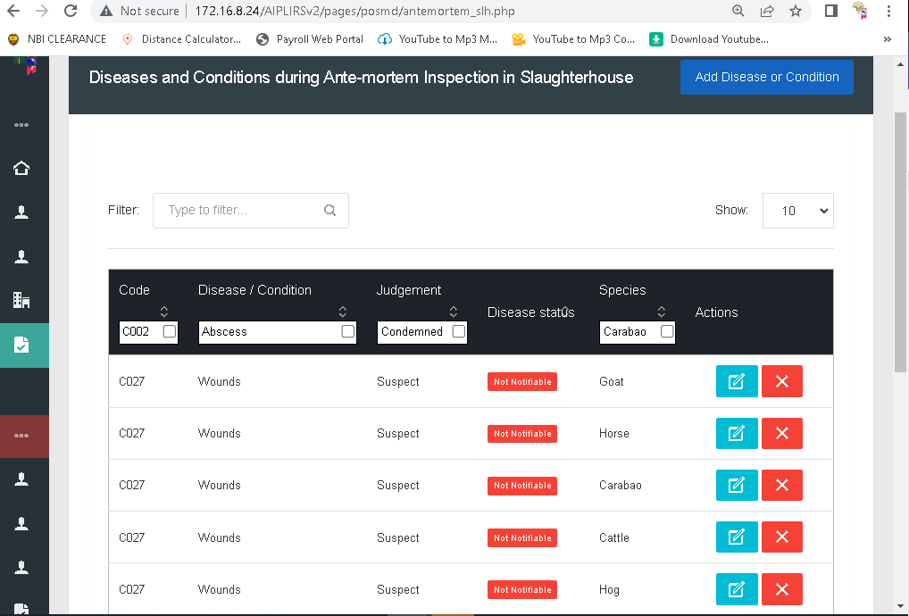
Notifiable : is to red bold text no background
Not notifiable: is to green bold text no background in all pages of diseases
Resolved: August 16, 2022

Slide 11
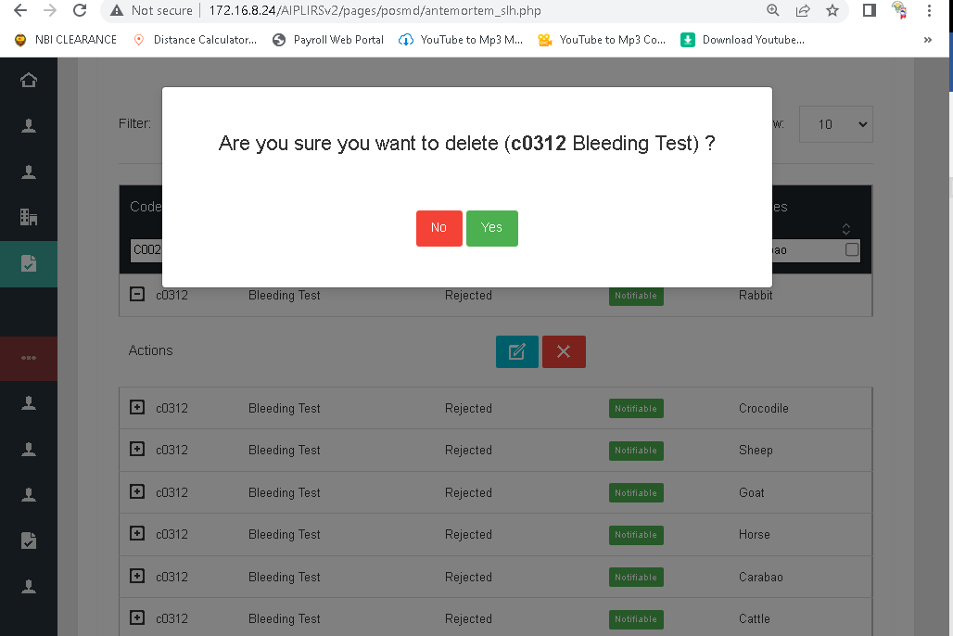
Remove parethesis
And remove unbold text
August 16, 2022
Remove spacing
August 16, 2022
First “Yes”
August 16, 2022

Slide 12
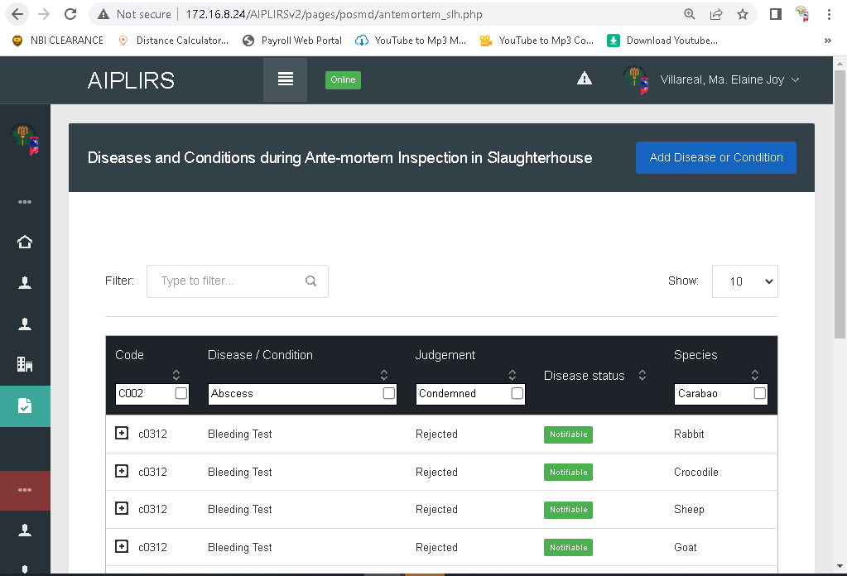
Move down button align right on the bottom of header
Resolved: August 16, 2022

Slide 13
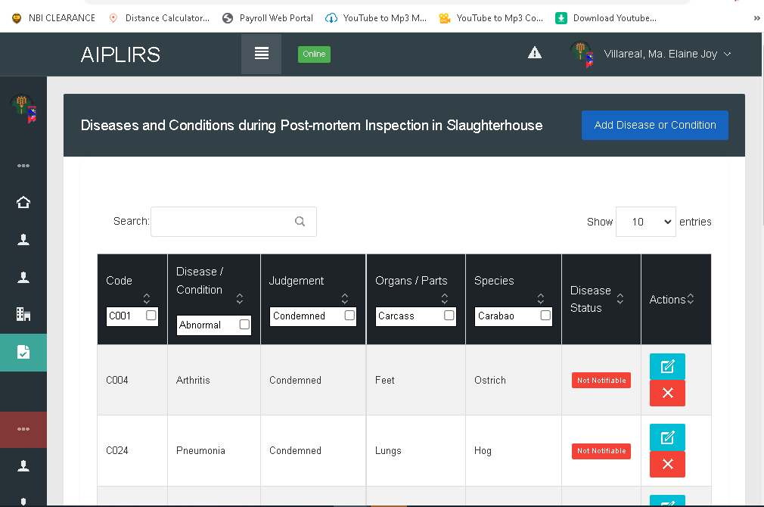
Change icon into word
Edit . Delete
August 16, 2022

Slide 14
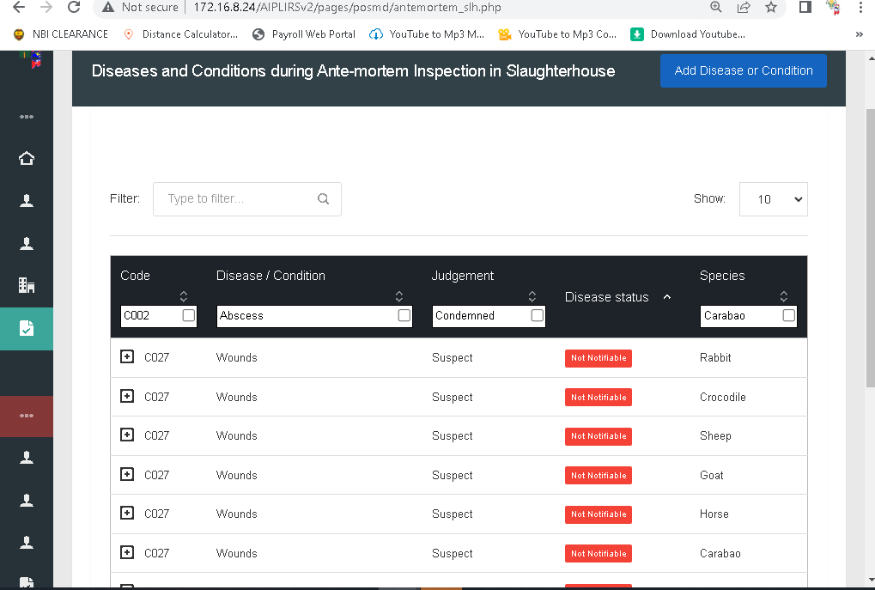
For the order of the table
Code, Disease or condition, judgement, species, Disease status, Actions
August 16, 2022
Instead of filter change to search in all pages of diseases
Resolved: August 16, 2022
Add a dropdown for filtering in all pages of diseases
Resolved: August 16, 2022
Remove plus button to make visible of actions
Resolved: August 16, 2022

Slide 15
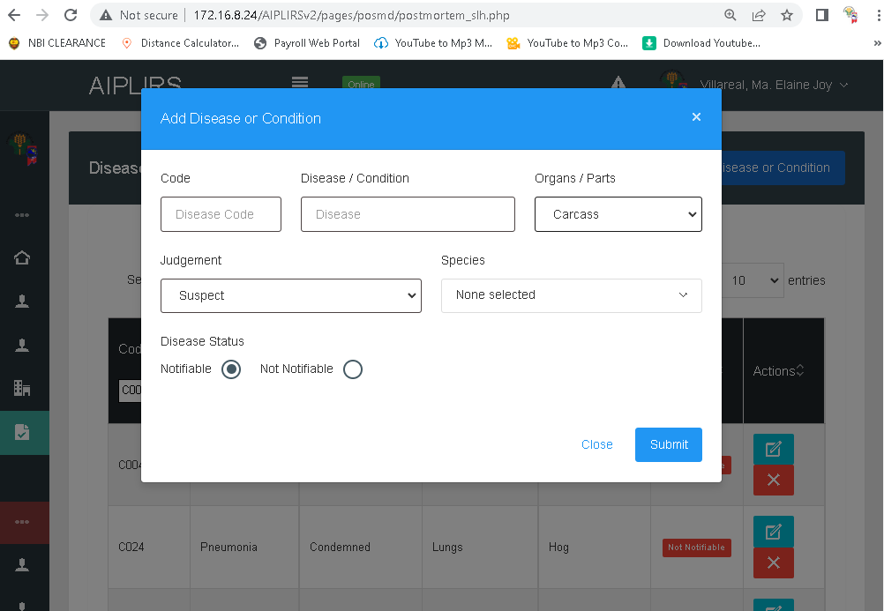
Multiple Selection Postmortem

Slide 16
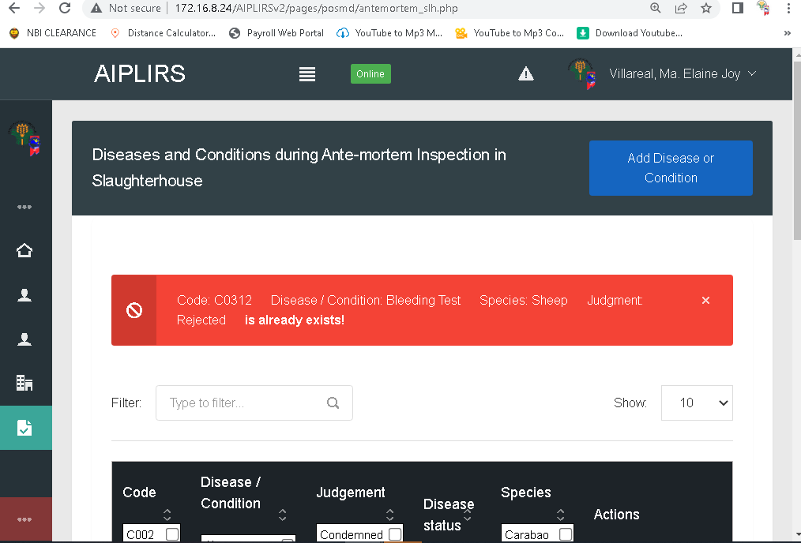
Change to “already exist”
Make white background red border
Pending
Color red, for the icon change to exclamation point
Specify each Species have duplicated data
Spelling of judgement
Capitalize Status in all disease pages

Slide 17
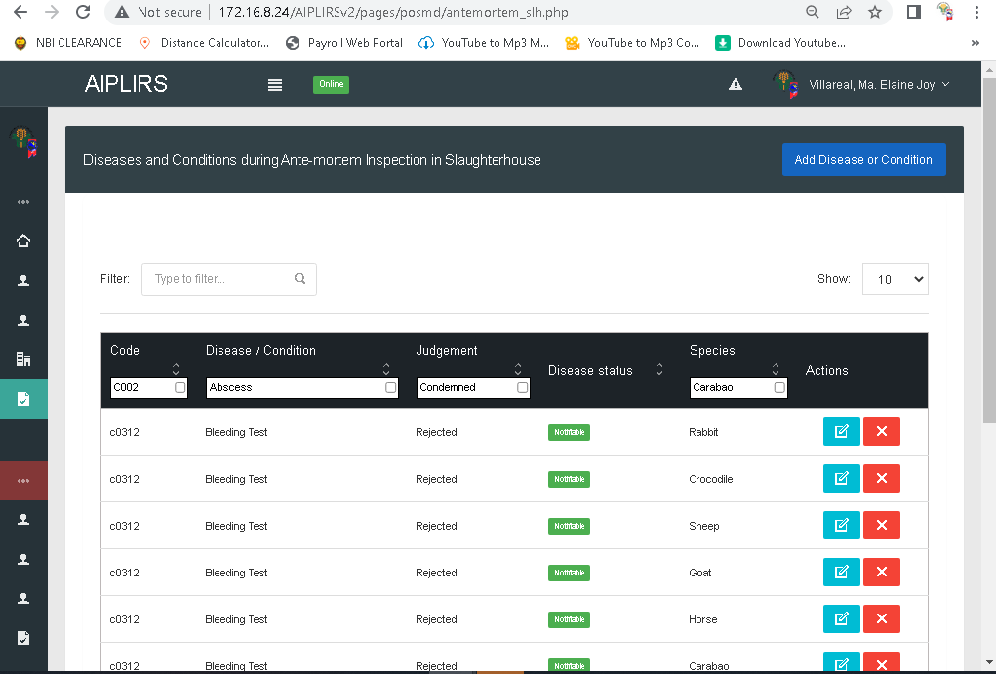
Stripe table row
Resolved: August 15, 2022
Change positioning to species after disease status
Resolved: August 15, 2022
Change label to select

Slide 18
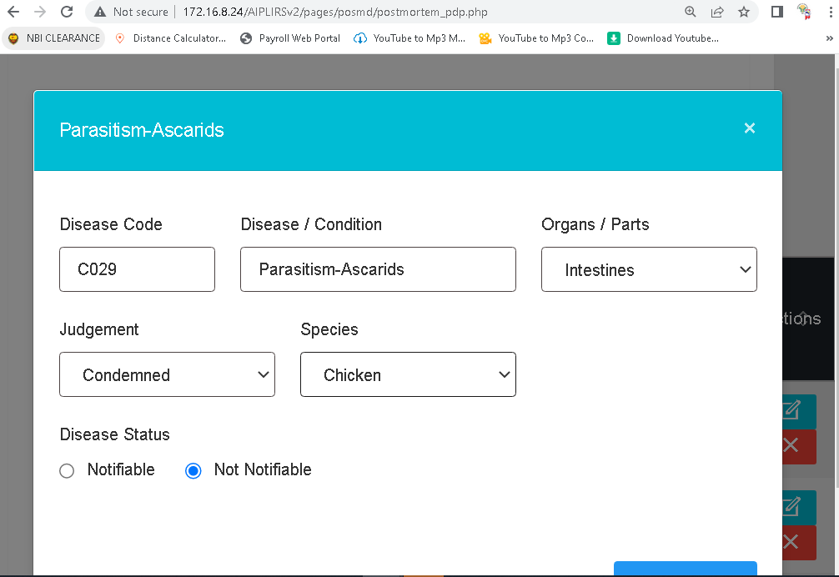
Update with multiple species insertion of data
Add a pegion and remove ostrich
Resolved: August 16, 2022

Slide 19
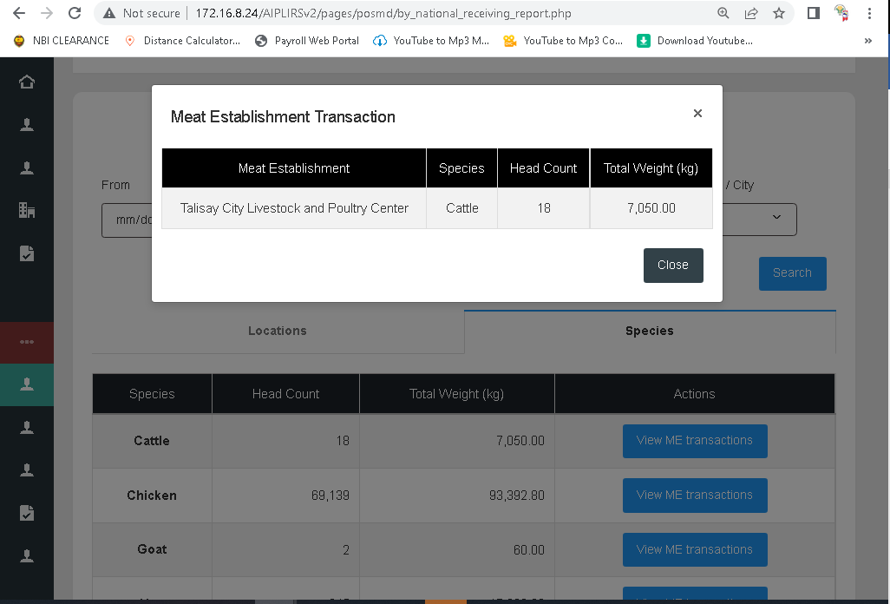
Another column “region” :
Resolved: August 16, 2022

Slide 20
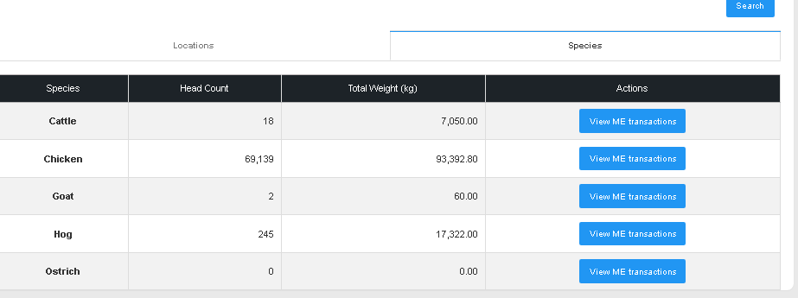
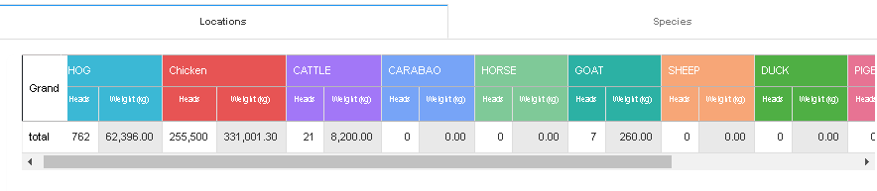
Result not equal change syntax
Resolve: August 16, 2022

Slide 21
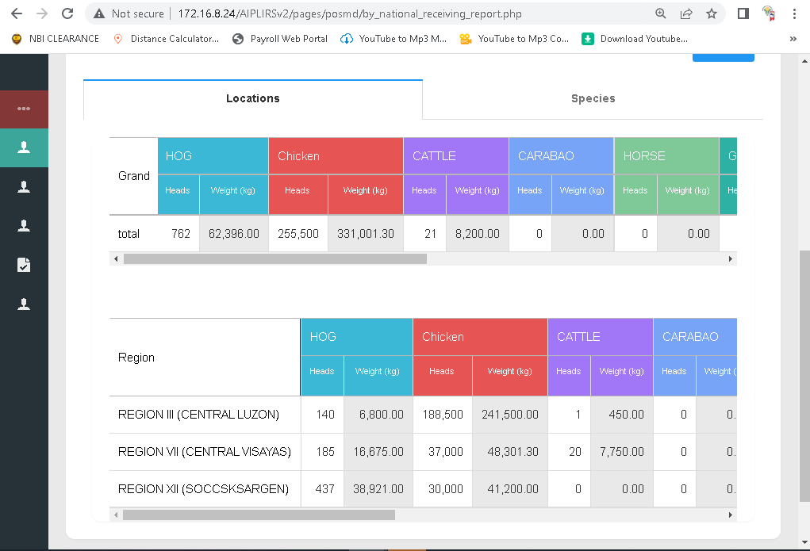
Filtering of National data receiving of animals
Change to Grand to grand total
Chicken make it all caps
Change to National Data
Resolved : August 16, 2022
Chicken make it all caps

Slide 22
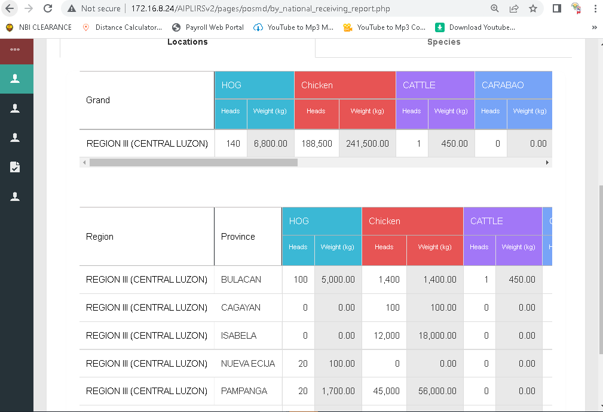
Filtering of Regional data receiving of animals
Chicken make it all caps
Change to Grand to grand total
Chicken make it all caps
Resolved : August 16, 2022

Slide 23
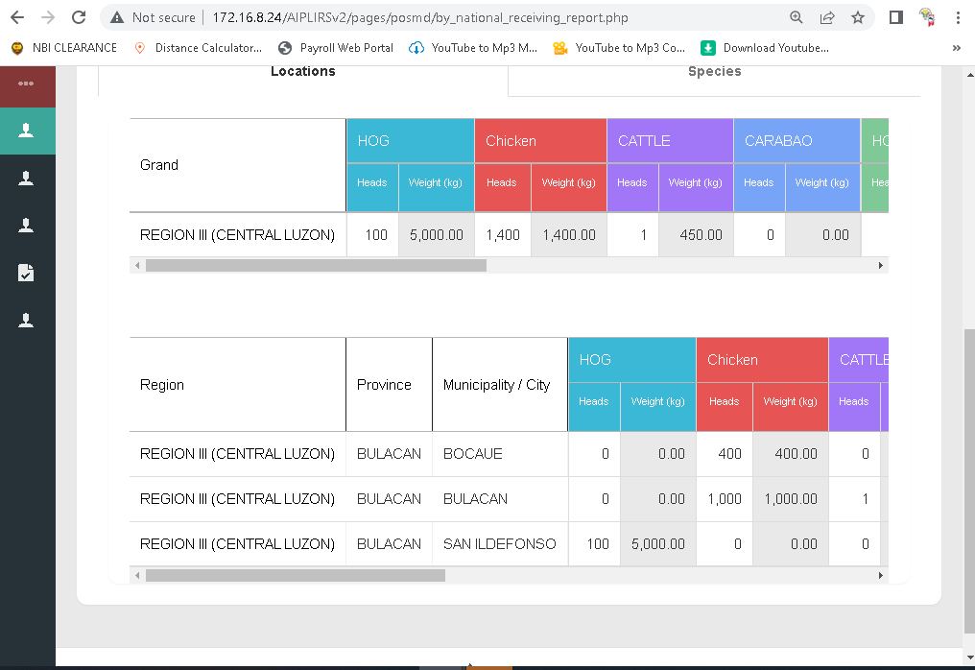
Filtering of Provincial data receiving of animals
Chicken make it all caps
Add a colum for province base in filter
Change to Grand to grand total
Resolved : August 16, 2022
Chicken make it all caps

Slide 24
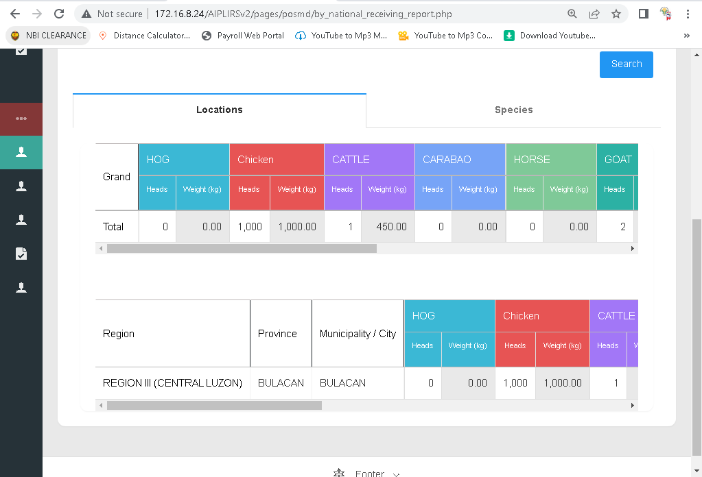
Filtering of Municipality data receiving of animals
Resolved : August 16, 2022
Remove this table
Add a column for the total merge by row

Slide 25
AUGUST 11, 2022

Slide 26
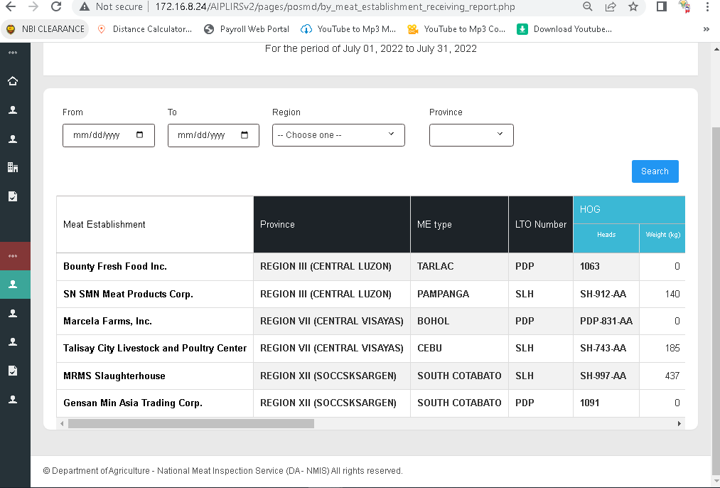
Additional Dropdown for city filtering
Align with the filter fields and rename search to filter
Bold text for the table header Meat Establishment
Missing Column for region
Add a live search and for the place holder “Meat Establishment”
Change to “Type”

Slide 27
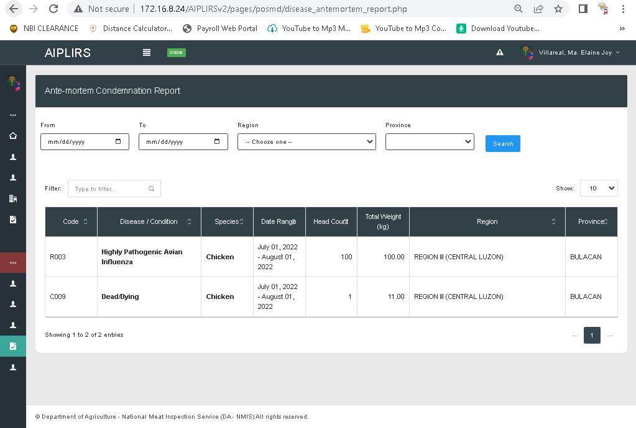
Change label to “search” input
Add dropdown for the municipality
Total head count
Change to Filter
Add a multiple filter for the disease / condition & species

Slide 28
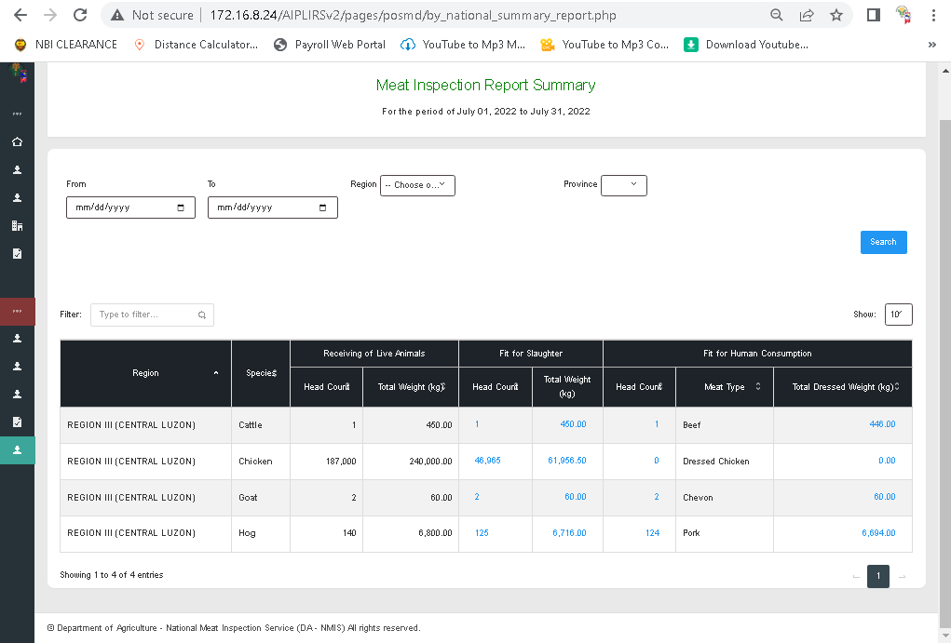
Result Check from the RECEIVING TO FIT FOR HUMAN CONSUMPTION
Add dropdown for the municipality
Chagne to filter label
Chamge to “receiving of animals
Change to total head count
Sorting unresponsive

Slide 29
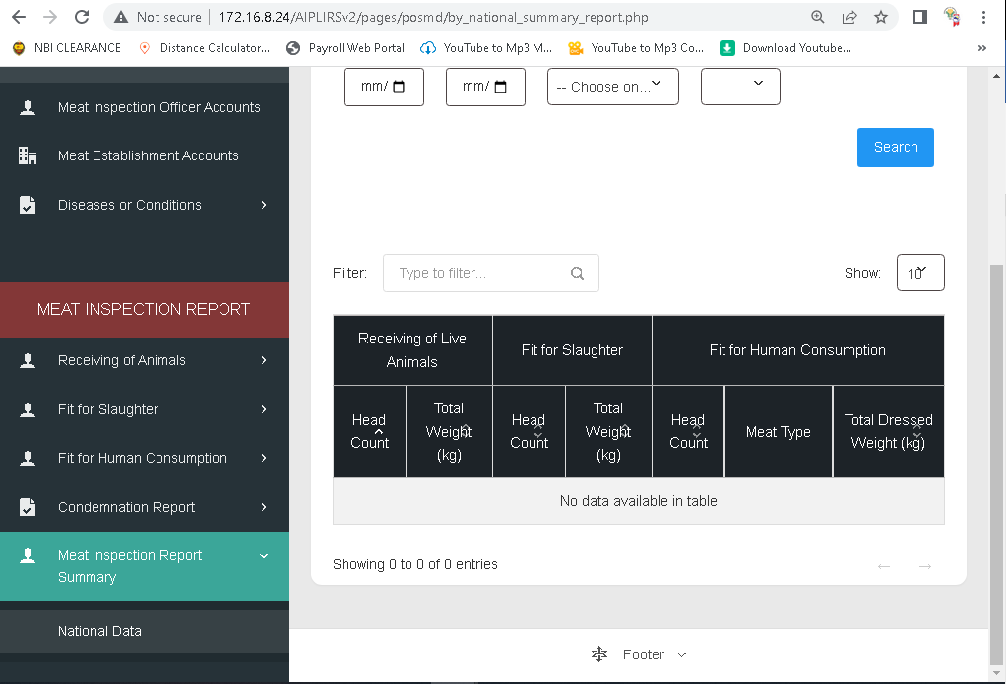
Add a dropdown and PAGE for the MEAT ESTABLISHMENT INSPECTION REPORT

